Slide 1
Managing Mobility in Cellular Networks
A Case Study of GSM Network

Slide 2
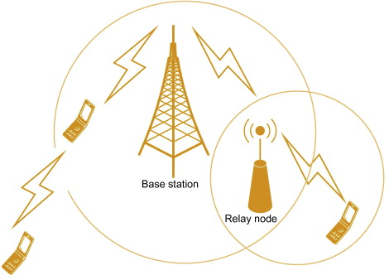
Cellular Networks
Type of wireless communication network where mobile devices communicate with each other and with a central hub known as a base station or cell tower.
The ability of a mobile device to move within the network's coverage area while maintaining an active connection is known as Mobility.

Slide 3
GSM cellular network
Stands for Global System for Mobile Communications
A second-generation (2G) technology
Digital cellular technology used for mobile communication.
Similar to Mobile IP (Internet Protocol), GSM adopts an indirect routing approach.

Slide 4
Home and Visited Networks
Home Network
This is the network is where the mobile user has a subscription and is billed for monthly cellular service.
Home Location Register (HLR) Database to store phone numbers and location information.
Visited Network
This is the network in which the mobile user is currently located.
Visitor Location Register (VLR) Database that includes entries for each mobile user currently within its coverage area.
Mobile Switching Center (MSC)

Slide 5
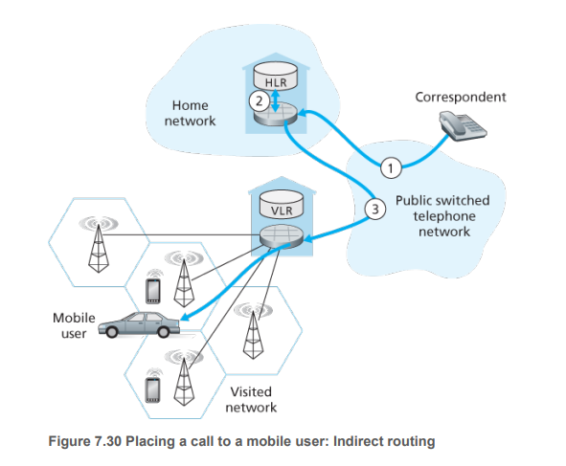
Routing Calls to a Mobile User
Initiating the Call:
Correspondent dials mobile user's number.
Call routed through PSTN to the home MSC, marking
Determining User Location:
Home MSC receives the call, interrogates HLR for user location.
HLR returns the mobile station roaming number (MSRN), a temporary identifier associated with the visited network.

Slide 6
Routing Calls to a Mobile User
Setting up Second Leg of the Call:
Using the roaming number, home MSC establishes the second leg of the call.
Call progresses from correspondent to home MSC, then to visited MSC, and finally to the base station serving the mobile user.

